Slide 1
Introduction To Software Testing

Slide 2
Introduction to Software Testing
Software Failure
Importance of Software Testing
Software Test Life Cycle

Slide 3
What is Software Testing
Introduction:
Software Testing is an activity that helps in identifying bugs/defects/errors in a software system under development, in order to provide a defect-free and reliable system/solution to the customer.
Software Testing is the process of questioning a product in order to evaluate it, where the "questions" are things the tester tries to do with the product, and the product answers with its behavior in reaction to the probing of the tester.
Software Testing helps to identify the correctness, completeness, and quality of developed computer software.Testing is the process of evatent of finding errors.
Software Testing is the process of evaluating a deliverable with the intent of finding errors.

Slide 4


Software Failures
Story 1: Amazon Christmas Glitch
It was quite a surprise for vendors to see their products on sale for just One penny in Amazon marketplace. It was a festive bonanza for shoppers and many picked up items as expensive as mobile phones for just 1 penny. This glitch was attributed to a bug in amazon price comparison software and resulted in $100,000 for the vendors.
Story 2: Brunswick Electric
A software glitch during the upgrade of Power stat program at Brunswick electric led to a power outage for hours together which impacted more than 4000 customers.

Slide 5

Software Failures
Story-3 : Disney’s Lion King
Disney company released its first multimedia CD-ROM game for children, The Lion King Animated Storybook. Sales was huge and it was “the game to buy” for children. Soon the phone support technicians were swamped with calls from angry parents with crying children who couldn’t get the software to work.
Reason:
It turned out that Disney failed to test the software on a broad representation of the many different PC models available in the market. It worked on the models – that the Disney programmers used to create the game.

Slide 6
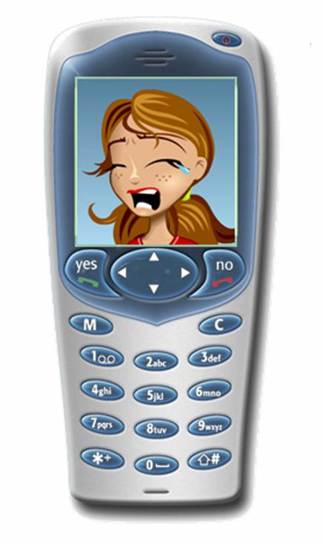
Software Failures
Story-4 : Mobile bug - may be few of your mobile has this (of course not the smart ones!!!)
Consider your friend’s (John) phone number is – 9981234567 and you have stored his name as John.
Now, dial the number as – 9841234567 and see what happens. It shows your friend name – John!!!
Reason : It checks only the last 7 digits to display the name!!!

Slide 7
Why is Software Testing Necessary?
“A clever person solves a problem. A wise person avoids it.”
- Albert Einstein
We test software to:
detect variations from specification/expectation
reduce risk inherent in computer systems
prove that a program is good or not good
support developers to build defect-free software by identifying defects
establish confidence that a program does what it is supposed to do
satisfy the customer and help them know what they want

Slide 8
Significance of Software Testing:
To produce a quality product, which is defect free.
To make sure all the requirements are satisfied and the best design system architecture is used.
To ensure Customers/user satisfaction.
To reduce the possible risks associated with the software, thereby reducing the loss.

Slide 9
How Testing Improves the Software Quality
Testing helps to measure the quality of software in terms of the number of defects found, the tests run, and the system requirements covered by the tests.
Testing helps to find defects and the quality of the software increases when those defects are fixed thereby reducing the overall level of risk in a system.
Testing helps to improve the quality by ensuring the product:
meets the user requirements
meets the conformance standards & Guidelines,
meets the performance standards
provides stability to the system

Slide 10
What is Software Defect
Definition:
Software Defect can be defined as non-conformance to requirements or functional specification.
Software defect is a common term used to describe error, fault, failure, bug, defect, etc.
Software defects are classified based on severity and priority.

Slide 11
Defects Classification
Bug /Defect / Fault
Error / Mistake
Failure
Notes:
Notes:
Bug/defect/fault: A flaw in a component or system that can cause the component or system to fail to perform its required function, e.g. an incorrect statement or data definition. A defect, if encountered during execution, may cause a failure of the component or system.
Mistake/error: A human action that produces an incorrect result. [The same as IEEE 610 standard]
Failure: Deviation of the component or system from its expected delivery, service or result.

Slide 12
Why does Software have bugs?
Common reasons for a defect in a software:
Misinterpretation/Misunderstanding of Business Requirements
Changing requirements
Software Complexity
Poor Design/Coding logic
Human errors
Notes:
Notes:
Miscommunication or no communication – As to specifics of what an application should or shouldn’t do (the application’s requirements). There is a high probability for these kinds of errors to occur when there are too many stake holders involved.
Software complexity – The complexity of current software applications can be difficult to comprehend for anyone without experience in modern-day software development.
Programming errors - Programmers, like anyone else, can make mistakes. These can be syntax or logical errors.
Changing requirements - The customer may not understand the effects of changes, or may understand and request them anyway – redesign, rescheduling of engineers, effects on other projects, work already completed that may have to be redone or thrown out, hardware requirements that may be affected, etc.
Poorly documented code - It’s tough to maintain and modify code that is badly written or poorly documented; the result is bugs.

Slide 13
Significance and Cost of Software Defect
40-1000X
Analysis of 63 projects cited in Software engineering economics: Boehm, 1981
30-70X
(82XIBM
Average)
15-40X
Relative cost to fix defect
10X
3-6X
1
Requirements
Design
Coding
Development
Testing
Acceptance
Testing
Operation
Notes:
Notes:
The presence of defects in a Software system has a negative impact on the quality of the Software and shows the deviations in the design practice and principles.
The cost of defect is directly impacted by when those defects are found.
The cost of finding and fixing defects rises considerably across the life cycle.

Slide 14
Key Considerations For Software Testing
How good does the product need to be?
How do we measure it?
How much will it cost?
Are we capable?
How do we make a decision?
Time and resource [human and machine]
We know what we need to do, but can we do it?

Slide 15
When To Stop Testing
Critical or Key Test cases successfully completed.
Certain test cases, even if they fail, may not be show stoppers.
Testing budget of the project or when the cost of continued testing, does not justify the project cost.
Functional coverage, code coverage, meeting the client requirements as per the target benchmark.
Defect detection rates fall below certain specified level & High priority bugs are resolved.

Slide 16
Principles Of Software Testing
Principle 1
Testing shows presence of defects
Principle 2
Exhaustive testing is impossible
Principle 3
Start testing early
Principle 4
Defects are clustered and not evenly distributed
Principle 5
Pesticide Paradox- testing identifies bugs
Principle 6
Testing is context dependent
Principle 7
Complete absence of errors is not possible
Notes:
Notes:
Principle 1 – Testing shows presence of Defects:
Testing can show that defects are present, but cannot prove that there are no defects. Testing reduces the probability of undiscovered defects remaining in the software but, even if no defects are found, it is not a proof of correctness. Lesser the number of defects in software, the better is the quality of the software.
Principle 2 – Exhaustive Testing is impossible:
Testing everything (all combinations of inputs and preconditions) is not feasible except for trivial cases. Instead of exhaustive testing, risk analysis and priorities should be used to focus testing efforts if the detailed testing is not feasible for various other reasons.
Principle 3 – Early Testing:
To find defects early, testing activities shall be started as early as possible in the software or system development life cycle, and shall be focused on defined objectives.
Principle 4 – Defect Clustering:
Testing effort shall be focused proportionally to the expected and later observed defect density of modules. A small number of modules usually contains most of the defects discovered during pre-release testing, or is responsible for most of the operational failures.
Principle 5 – Pesticide Paradox:
If the same tests are repeated over and over again, eventually the same set of test cases will no longer find any new defects. To overcome this "pesticide paradox", test cases need to be regularly reviewed and revised, and new and different tests need to be written to exercise different parts of the software or system to find potentially more defects.
Principle 6 – Testing is Context Dependant:
Testing is done differently in different contexts. For example, safety-critical software is tested differently from an e-commerce site.
Principle 7 – Absence-of-errors fallacy:
Finding and fixing defects does not help if the system built is unusable and does not fulfil the users’ needs and expectations.

Slide 17
Introduction To Software Testing
1. Coast of fixing the defect decreases as it moves to later stages
True
False
Notes:
Answer: False

Slide 18
Introduction To Software Testing
2. Which principle of testing says we cannot perform rigorous testing on the application
Pesticide paradox
Early testing is better
Exhaustive testing is impossible
Defect clustering
Notes:
Answer: Exhaustive testing is impossible

Slide 19
Introduction To Software Testing
3. Reasons for defect in application are:
Human Errors
Changing Requirements
Complexity of the project
All of the Above
Notes:
Answer: All of the above

Slide 20
Software Test Life Cycle

Slide 21
CONTENT
What is Software Testing Life Cycle?
Phases of STLC
Test Strategy
Test Plan
Test Design
Test Environment Setup
Test Execution
Defect Reporting
Test Closure

Slide 22
SOFTWARE TESTING LIFE CYCLE
STLC defines the stages/phases in testing of software.
In general, software testing starts from the requirement phase and ends with the deployment phase.
Test Strategy
Stages of STLC
Test Plan
Test Design
Test Environment
Test Execution
Defect Reporting
Test Closure
Notes:
STLC defines the stages/phases in testing of software. Sometimes some of these phases may run in parallel. For e.g design and execution.

Slide 23
PHASES OF STLC
Test Strategy
Test Plan
Test Design
Test Environment Setup
Test Execution
Defect Reporting
Test Closure
A concise statement of how to meet the objectives of testing effectively in limited time by optimal use of resources.
The intent is to establish the framework for testing the system and work products to be delivered to the client.
Depending on the type of testing, different set of requirements such as functional, business, technical, performance etc., are analyzed.
Notes:
This is the first phase of STLC. Steps for preparation of test strategy are:
Is the system Testable
Identify the product elements in the system
Identify the quality factors expected to be demonstrated
Identify the quality criteria for each of the quality factors
Identify test factors you wish to test for
Prioritize the test factors to test the system
For each of the factor, identify the lifecycle stage in which it needs to be tested?
For each factor, lifecycle combination, check if the drivers are present or not?
Identify the following for every lifecycle – factor combination:
Methodology [Verification / Validation]
Approach [Black Box / White Box]
Focus [Functional / Structural]
Method [Dynamic / Static]
Prioritize the strategy in alignment with the development strategy adopted by the project
Discuss and base-line the strategy for testing the project
The intent of the Test Strategy is to establish the framework for testing the system and work products to be delivered to the client.
Test Strategy is a concise statement of how to meet the objectives of software testing:
To Clarify expectations with the user, sponsor and bidders
To Describe the details of how the testing team will evaluate the work products, system, testing activities and results
To describe approach to all testing phases and the activities for which they are responsible
A strategy for software testing must
accommodate low-level tests that are necessary to verify that a small source code segment has been correctly implemented as well as high-level tests that validate major system functions against customer requirements
provide guidance for the practitioner and a set milestones for the manager
Generic characteristics of software testing strategies:-
Testing begins at module level and works outward towards the integration of entire computer based system.
Different testing techniques are required at different point of time.
Testing is conducted by the software developer and ITG (Independent Test Group ) for large projects.
Testing and Debugging are different and Debugging is essential in any testing strategy.

Slide 24

PHASES OF STLC
Test Strategy
Test Plan
Test Design
Test Environment Setup
Test Execution
Defect Reporting
Test Closure
Defines the level of participation & responsibilities for the relevant stakeholders such as Project manager, Development team, Test team, QA Team, Technical writers, Logistics, Users and Sponsors
Activities:
Identifies the types of testing to be performed based on the different types of requirements
Analyses and understands the requirements
Software Tester

Slide 25
PHASES OF STLC
Test Strategy
Test Plan
Test Design
Test Environment Setup
Test Execution
Defect Reporting
Test Closure
A document that contains:
Objectives
Scope of testing
Approach to be followed
Schedule
Roles and responsibilities
Notes:
This is the planning phase. In this phase planning is done for what needs to be tested, how the testing will be done, test strategy to be followed, what will be the test environment, what test methodologies will be followed, hardware and software availability, resources, risks etc.

Slide 26

PHASES OF STLC
Test Strategy
Test Plan
Test Design
Test Environment Setup
Test Execution
Defect Reporting
Test Closure
Activities:
Creates the test plan deliverable according to standards
Determine roles and responsibilities
Test Effort Estimation
Test Lead

Slide 27
PHASES OF STLC
Test Strategy
Test Plan
Test Design
Test Environment Setup
Test Execution
Defect Reporting
Test Closure
Test Case Basics
IEEE Standard 610 (1990) defines a test case as, “A set of test inputs, execution conditions, and expected results developed for a particular objective, such as to exercise a particular program path or to verify compliance with a specific requirement.”
A test is not necessarily designed to expose a defect but to gain information.
E.g. whether the program will pass or fail the test.
Very often, the information sought involves defects, but not always.
Notes:
Just as code is designed and developed, test cases too must be designed and then written.
Exhaustive testing of any non-trivial system is impractical. The input data domain is extremely large.
Test case design is required to derive an optimal test suite which is of reasonable size and uncovers as many errors as possible.
Helps in Arriving an optimal number of test cases.
A judicious set of tests are designed that test as much of the functionality as possible in a short span of time.
Randomly selecting or writing test cases does not indicate effectiveness of the testing.
Writing a large number of test cases does not mean that many errors in the system would be uncovered.

Slide 28
PHASES OF STLC
Test Strategy
Test Plan
Test Design
Test Environment Setup
Test Execution
Defect Reporting
Test Closure
Test Cases:
Identify and communicate the conditions that will be implemented in test
Necessary to verify successful and acceptable implementation of the product requirements
Help find problems in the requirements or design of an application
Determine whether we meet the Client expectations
Help managers make ship / no-ship decisions

Slide 29
PHASES OF STLC
Test Strategy
Test Plan
Test Design
Test Environment Setup
Test Execution
Defect Reporting
Test Closure
Decides the software and hardware conditions in which the software is tested.
Input data for any kind of test is called Test Data. Tester may provide this input data at the time of executing the test cases or application may pick the required input data from the predefined data locations.
E.g: Files, tables, xml files etc.
Notes:
Test Environment is setup based on the conditions under which the software gets tested. The environment generally setup by the developer or client. This is an independent activity and can be started parallel with Test Case development. Tester has to run a few random test cases (called as smoke testing) to check the readiness of the environment.

Slide 30
PHASES OF STLC
Test Strategy
Test Plan
Test Design
Test Environment Setup
Test Execution
Defect Reporting
Test Closure
Activities:
Depending on the type of test, hardware and software requirement list is prepared
Performs readiness test on the test environment to ensure that the environment is ready to perform testing
Technical team sets up the test environment
Software Tester

Slide 31
PHASES OF STLC
Test Strategy
Test Plan
Test Design
Test Environment Setup
Test Execution
Defect Reporting
Test Closure
Test execution is the process of executing all or a selected number of test cases and observing the results.
_{• Test Cases/Procedures}
_{• Test Data}
_{• Test Environment}
_{Previous Defect Information}
_{Execute Tests}
_{Software (To Be Tested)}
_{Test Plans & Strategy}
_{Test Incident Reports}
_{Test Log}
_{Testing Status & Results}
Notes:
By-products of test execution are test incident reports, test logs, testing status, and results.
Test Execution Process comprises of:
Test Case Execution
Error reporting
Error resolution
Test status reporting
Execute Test cases
Observe compliance with
functional requirements
system performance
capacity requirements
systems design effectiveness
system recoverability
system operability
Identify, document, and report test discrepancies

Slide 32
PHASES OF STLC
Test Strategy
Test Plan
Test Design
Test Environment Setup
Test Execution
Defect Reporting
Test Closure
By executing Unit, Integration and System Test Cases we can:
Validate the system against requirements
Verify code for correctness and conformance to standards
Build the system by having good interfaces among constituents
Understand limitations of the system
Compare system performance
Identify list of open bugs
Have sufficient grounds to decide on releasing the product
^{Responsible Group} | ^{Unit} | ^{Integration} | ^{System} | ^{Acceptance}
^{Testers} |  | ✓ | ✓ | ✓
^{Developers} | ✓ | ✓ | ✓
^{End-Users} |  |  | ✓ | ✓

Slide 33
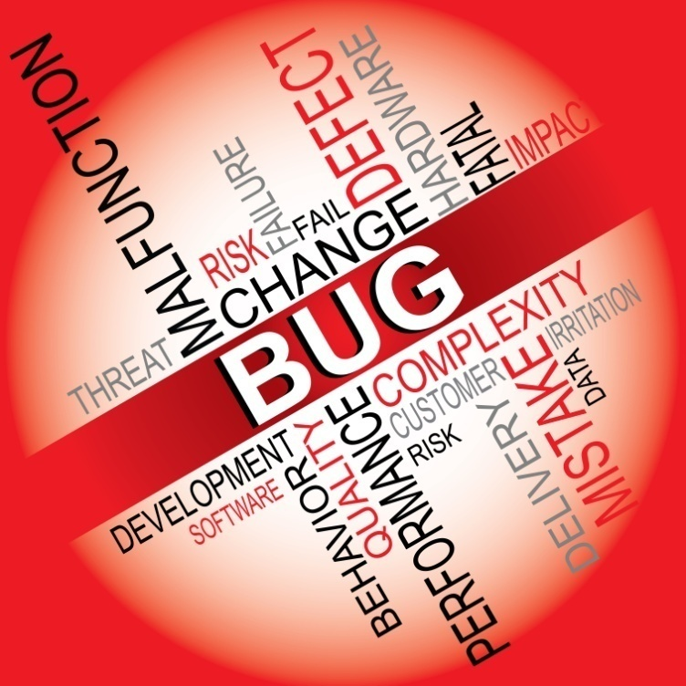
PHASES OF STLC
Test Strategy
Test Plan
Test Design
Test Environment Setup
Test Execution
Defect Reporting
Test Closure
The process of identifying defects in an application by testing and reporting to the development team.
When executing the test, tester compares the expected and actual results and logs a defect when there is discrepancy. The defects are documented in a deliverable called System Investigation Request(SIR).
Notes:
The “failed” defects are reported to the development team through the bug tracking system. Once the bug is fixed by the development team then the same test case can be re-executed.

Slide 34
PHASES OF STLC
Test Strategy
Test Plan
Test Design
Test Environment Setup
Test Execution
Defect Reporting
Test Closure
Activities:
Compares the expected and the actual results of each step in test script deliverable
Logs defects if there is discrepancy
Software Tester

Slide 35

PHASES OF STLC
Test Strategy
Test Plan
Test Design
Test Environment Setup
Test Execution
Defect Reporting
Test Closure
Upon successful completion of the test execution, the test stage is formally closed. This is achieved through a deliverable called test closure memo.
Notes:
During this phase a meeting of test team members is conducted and cycle completion criteria based on Test coverage, Quality, Cost, Time, Critical Business Objectives, and Software is evaluated. The strong and weak areas are identified and learning from current STLC is taken as input to upcoming test cycles. Test case & bug reports are analysed to find out the defect distribution by type and severity. Test closure memo and Test metrics are prepared.

Slide 36
PHASES OF STLC
Test Strategy
Test Plan
Test Design
Test Environment Setup
Test Execution
Defect Reporting
Test Closure
Activities:
Documents all major tasks that have been performed to ensure successful hand over
Prepares the test metrics
Evaluates the test completion criteria based on test coverage and critical business objectives
Prepares the test closure memo
Test Lead

Slide 37
OVERVIEW OF STLC
Phase | Activity | Deliverables
Test Strategy | Analyze and understand the requirements | Test Strategy Document
Test Plan | Estimate the efforts, roles and responsibilities | Test Plan
Test Design | Detail the tests based on detailed requirements/design | Test Scripts
Test Environment Setup | Set Up Server/Client/Network/file etc. environment needed for testing | Test Environment
Test Execution and Defect Report | Execute test cases in the test environment | Defect Reports
Test Closure | Evaluate the test completion criteria based on test coverage and critical business objectives | Test Metrics and Test Closure Memo
Notes:
Here is a quick summary of the different phases of STLC.

Slide 38
QUIZ QUESTION
Software Testing activity should start -
As soon as the code is written
During the design stage
When the requirements have been formally documented
As soon as possible in the development life cycle
Notes:
Answer: As soon as possible in the development life cycle

Slide 39
Introduction to Software Testing
Software Failure
Importance of Software Testing
Software Test Life Cycle

